Slide 1
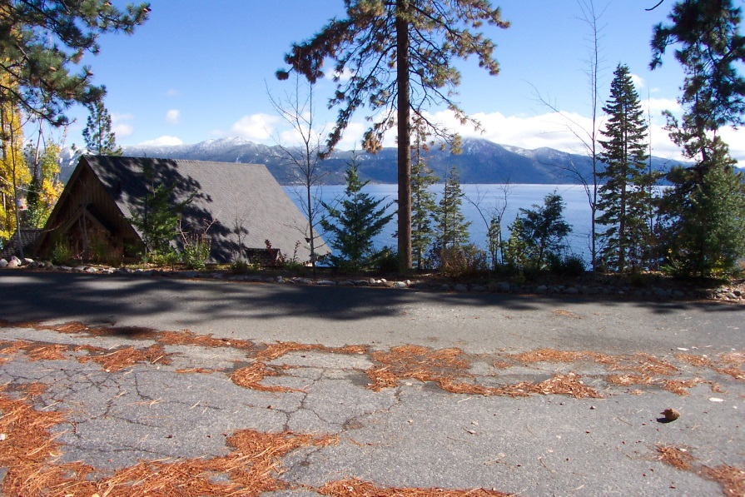
Variance WVAR16-0003
Snyder Residence
540 Gonowabie Road
Crystal Bay
  Requesting to reduce the setback from the road, from 15 feet to 1.7 from edge of road to construct a garage

Slide 2
Analysis

Slide 3
Analysis
Property is bisected by the road
No easement or right-of-way for existing road

Slide 4
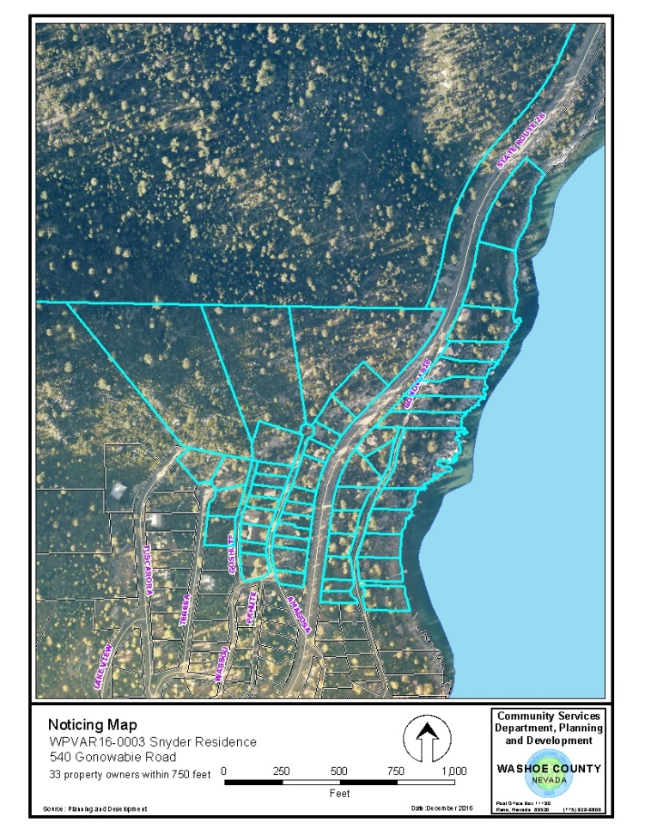
Public Notice
Incline Village/Crystal Bay CAB
No CAB meetings are held between November and February
Application was sent to CAB members
Public Notice
33 separate property owners notified
No comments were received from CAB or public

Slide 5
Reviewing Agencies
Washoe County Community Services Department
  Planning and Development
  Engineering and Capital Projects
    Traffic
    Land Development

Slide 6
Conditions of Approval
Standard Planning requirements
7 foot separation from edge of pavement to structure
Parking management during construction
Hold Harmless agreement
Garage door opener required

Slide 7
Findings
Special circumstances
- Exceptional slope and the road crossed private land without a recorded easement
No detriment
- Conditions of approval mitigate detriment
No special privileges
- Adjacent properties have been granted similar setback reductions
Use authorized
- Proposed garage is permitted in MDS

Slide 8
Motion
I move that, after giving reasoned consideration to the information contained in the staff report and information received during the public hearing, the Washoe County Board of Adjustment approve Variance Case Number WPVAR16-0003 to reduce the set back from fifteen feet to seven feet from the edge of the roadway pavement for Patrick and Filomena Snyder, with the Conditions of Approval included as Exhibit A for this matter, having made all four findings in accordance with Washoe County Development Code Section 110.804.25.

Slide 9
Discussion
Questions?

Slide 10
Motion (as requested)
I move that, after giving reasoned consideration to the information contained in the staff report and information received during the public hearing, the Washoe County Board of Adjustment approve Variance Case No. WVAR17-0003 Snyder Residence, with the conditions included in Exhibit A to the staff report for this matter, deleting condition 2.a., having made all four required findings in accordance with Washoe County Code Section 110.804.25.

